Slide 1
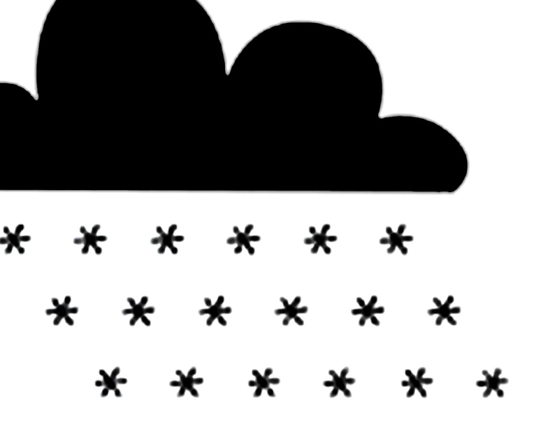
Critical Perspectives
On Climate Change
“The project has been funded with support from the European Commission. The contents of these actions are the sole responsibility of the contractor and can in no way be taken to reflect the views of the European Union.

Slide 2
Learning Objectives (English)
Differentiate between fact and opinion
Assess the reliability of different sources of information, and give reasons for your judgement
Use available information to develop your own knowledge and opinions
Present your findings in a clear and comprehensive manner to the class

Slide 3
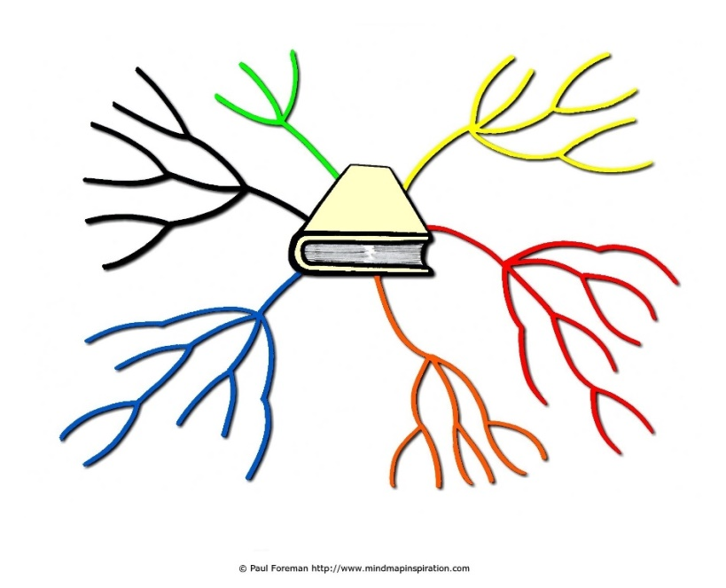
What do you know, think, or assume about climate change?
In small groups or tables, create a mind-map and write down everything you know, think or assume about climate change
If your group has differing opinions, write them all down
Use highlighters or different coloured pens to indicate which pieces of information are fact and which are opinion

Slide 4
Debrief
Share some different ideas from your mind-map with the class
Do you mostly agree with each other? Who disagrees and why?
How do you define ‘fact’?
How do you define ‘opinion’?
What do you think the best way to develop an opinion is?

Slide 5
Who to believe?
There are lots of differing opinions on climate change and humans influence over it
In pairs, read through the information sheets you have been given. There are 7 in total.
Determine which ‘source’ and ‘background’ match up with your information sheet, write down the corresponding numbers
Give each piece of information a ‘credibility score’ of between 1 and 10, with 1 being unreliable and 10 being very reliable
Write down a reason for your choices and score

Slide 6
Debrief
Were you able to read closely enough to find the information that matched the source and background?
Which information did you give this highest credibility score and why?
What are some of the differing opinions in the class?

Slide 7
What makes an argument credible?
Are you aware of the perspective that you bring when you assess information, and how that affects your opinion on it?
For the following few slides, move around the room to indicate your answer
Have a 5 minute class debate about your opinions on what makes you trust a source of information more
After the debate, see if anyone wants to change their answer before moving onto the next slide

Slide 8
Geographic remit of organisation
LOCAL
NATIONAL
INTERNATIONAL
Deep in one community, ear to the ground, access to local knowledge. May miss out on wider context and influences.
Broader view that includes the whole character of a country, access to larger resources. May miss out on local knowledge or international knowledge.
Broadest view that includes the whole world, access to large pool of knowledge and resources. May be very out of touch with on-the-ground experience.

Slide 9
Approach to understanding the world
SCIENTIFIC
JOURNALISTIC
HUMANIST
Uses tests to verify facts and posit hypothesise, and has results checked over and verified by other scientists
Investigates and explores situations, researches information/facts proposed by others, and sometimes applies a perspective/personal analysis
Emphasizes empathy and stresses the good in human nature. In politics and social theory, this approach calls for human rights and equality.

Slide 10
Level of establishment
WELL ESTABLISHED
NEWLY CREATED
Has a lot of experience and knowledge built up over time, but could be ‘stuck in their ways’
Lacks experience and knowledge, but could bring a fresh perspective

Slide 11
Approach to the government
WORKS WITH THE GOVERNMENT
WORKS AGAINST THE GOVERNMENT
STAYS INDEPENDENT AND NON-PARTISAN
Broadly agrees that the government is working for the people, and supports the implementation of their policies
Broadly disagrees with government policy and believes they primarily serve private interests
Doesn’t take a stance on any political party, refuses government funding to stay impartial, and only focuses on the issues they are concerned with

Slide 12
Approach to the UN
ADVISOR TO THE UN
ANTAGONIST TO UN
BENEFICARY TO UN
Provides information and research to inform the UN when they develop policy decisions
Believes that UN is out of touch with the local needs of member states and advocates state sovereignty
Receives funding or other support from the UN to carry out projects in line with their aims

Slide 13
Use of research
CARRIES OUT OWN RESEARCH
EVALUATES RESEARCH BY OTHERS
EMPIRICALLY VERIFIED
Uses a variety of scientific methods to test hypothesise and is open to peer-critique from others to strengthen their conclusion
Takes a range of research by different people and evaluates it all together to understand a broader context
Testing/exploring something though personal observations

Slide 14
Conclusion
Did the class mostly agree on each answer?
Did debating the different perspectives make you change your answer at all?
As a result of the class debates, have you change your opinion on any of the information sources provided earlier? If so, why?

Slide 15
Your own viewpoint…
Using the information you have read, the debates you have had, and your own personal perspective, consider your opinion on anthropogenic climate change
Write a paragraph that outlines your opinion, and the reasons behind it
Present your ideas and opinion to the class

Slide 16
Think before you speak!
Everyone is entitled to an opinion
(You are not always entitled to express that opinion, if in doing so you oppress other people e.g. hate speech)
What do you think the best way to form an opinion is?
Be prepared to be mocked if your opinion is formed on ignorance and assumptions! Especially if you are a public figure…
Click for Video

Slide 17
