Slide 1
The history of human rights
Educating for a just and sustainable world
The project ‘Global Fairness: Schools as Agents of Change’ has been funded with support from the European Commission. The contents of these actions are the sole responsibility of the contractor and can in no way be taken to reflect the views of the European Union.
Notes:
This powerpoint contains some notes to teachers that may be useful in generating discussions or delving deeper into some topics.

Slide 2
Learning Objectives
You will have considered the evolution of Human Rights
You will understand the roles leaders and citizens play in the evolution
You will reflect on the relationship between rules and rights

Slide 3
Discuss in pairs which of these statements you find most interesting

Slide 4
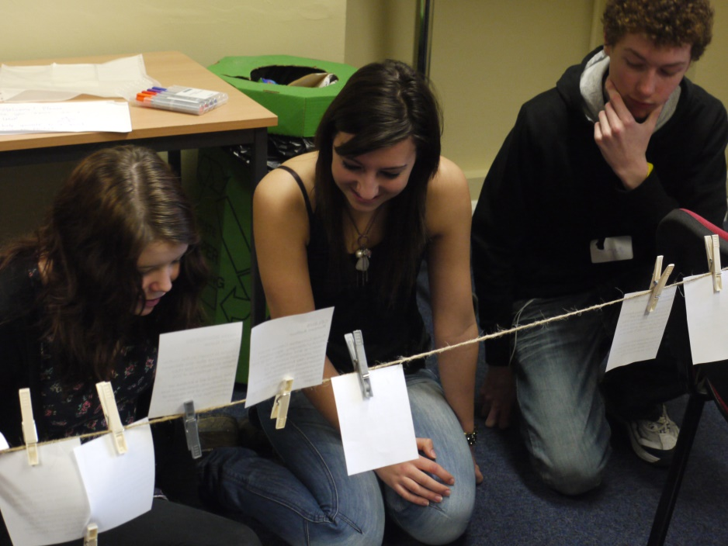
Timeline trauma
Dates relating to the evolution of human rights have got mixed up! In pairs re-order the timeline and match the event to the date.

Slide 5
How well did you do?
Let’s find out…

Slide 6
The beginnings of human rights
1754 BC
Code of Hammurabi
539–538 BC
Cyrus cylinder
268- 232 BC
Edicts of Asoka

Slide 7
Code of Hammurabi

Slide 8
Code of Hammurabi
Hammurabi: ruler of Babylon (1792-1750 BC) - supremacy in Mesopotamia
The Code regulates family law, slavery, and professional, commercial, agricultural and administrative law. The longest chapter concerns the family, which formed the basis of Babylonian society.
Q: One law is relates to what should be done if a son strikes his father…
A) The father shall strike the son twice.
B) The son’s hand shall be cut off.
C) The father can kill the son.
B) The son’s hand shall be cut off!
It is now in the Louvre (Paris) (The Code, not the hand.)
Source: http://www.louvre.fr/en/oeuvre-notices/law-code-hammurabi-king-babylon

Slide 9
Cyrus cylinder

Slide 10
Cyrus cylinder
Cyrus: King of Persia (539–538 BC)
Enactment of laws for the liberation of slaves, to freedom of religion and equality of all people Held on clay cylinders Some historians as well as writers on human rights, have supported the interpretation of the Cyrus Cylinder as the first human rights charter
Is now at the British Museum (London)
Source: http://www.humanrights.com/what-are-human-rights/brief-history/cyrus-cylinder.html

Slide 11
Edicts of Asoka

Slide 12
Edicts of Asoka
Asoka: King of India (268- 232 BC)
Gave himself the nickname "the Humane" Edicts: moral and religious issues, call for the moral life and to peace, tolerance and kindness Edicts were circulated as rock inscriptions and on pillars in India, Nepal, Pakistan, Bangladesh, and Afghanistan.
source:
https://www.khanacademy.org/humanities/art-asia/south-asia/buddhist-art2/a/the-pillars-of-ashoka

Slide 13
Other milestones of human rights
1215
Magna Carta
1791 USA
Bill of Rights
1948 Universal Declaration of Human Rights
1989 Convention on the Rights of the Child
1959 The Declaration of the Rights of the Child

Slide 14
1215 Magna Carta

Slide 15
1215 Magna Carta
English subjects forced King John of England, to sign the Carta and agree to Freedom of the Church Right to property (for free citizens) Protection against excessive taxes Ordinary trial
Source: http://www.humanrights.com/what-are-human-rights/brief-history/magna-carta.html

Slide 16
Scope of the Magna Carta
Applied only to a small privileged minority of the nobility and later other "free men"

Slide 17
1791 Bill of Rights

Slide 18
1791 Bill of Rights
10 Amendments to the US Constitution: Protection of freedom of speech, assembly and religion Right to bear arms Ordinary trial Prohibition of cruel or unusual punishment
Source: http://www.humanrights.com/what-are-human-rights/brief-history/declaration-of-independence.html

Slide 19
Scope of the Bill of Rights
The rights set out were primarily for white men Women in the United States achieved the right to vote in 1920 Members of the First Nations (people who lived there before European settlers) achieved the right to vote in 1924
Q: African Americans achieved the right to vote in
1926
1965
1976
b) 1965

Slide 20
1948 Universal Declaration of Human Rights

Slide 21
1948 Universal Declaration of Human Rights
Based on experiences of injustice of colonialism and the horrors of World War 2 30 items Goal: peace and protection worldwide Signed by all Member states of the United Nations
Article 1 All human beings are born free and equal in dignity and rights. [...]
Article 2 Everyone is entitled to all forth in this Declaration rights and freedoms without distinction of any kind [...]
Article 3 Everyone has the right to life, liberty and security of person.
Article 4 No one is allowed in slavery or servitude are held; Slavery and the slave trade in all their forms shall be prohibited.

Slide 22
Scope of the UDHR
The UDHR (Universal Declaration of Human Rights) was signed by all member states- the UDHR therefore has a universal validity claim. Nevertheless, human rights are still violated (death penalty, torture, expulsion, persecution, oppression, discrimination ...)

Slide 23
1959 The Declaration of the Rights of the Child
First document to ever provide a special set of rights specifically to children

Slide 24
1989 The Convention on the Rights of the Child
Expands on the rights in the declaration
Children are guaranteed the right to play
Q: The only country that hasn’t signed up is….?
A) Saudi Arabia
B) USA
C) Brazil
B) USA
Notes:
Discussion questions:
What rights do you think you need as a child?
How are these different from the rights that should be guaranteed to all adults?

Slide 25
Human Rights Today
2007 Declaration on the Rights of Indigenous Peoples
2010
UN Resolution right to clean water
2011
Guidelines of the United Nations for corporate responsibility

Slide 26
2007 Rights of Indigenous Peoples

Slide 27
2007 Rights of Indigenous Peoples
Recognition of historical injustice (colonialism) Protection against discrimination Right to Land and Resources Right to self-determination Right to their own political, legal, social, economic and cultural institutions
Source: http://www.ohchr.org/EN/Issues/IPeoples/Pages/Declaration.aspx
Notes:
Questions for discussion:
Have you heard the term indigenous peoples? What do you think it means?
Are these rights always provided to indigenous peoples?

Slide 28
2010 right to clean water

Slide 29
2010 Right to clean water
Adopted by 122 members of the United Nations Recognising that the right to clean water and sanitation is essential for the realisation of human rights Demand for financial support to facilitate access to water and sanitation
http://www.un.org/waterforlifedecade/human_right_to_water.shtml
Notes:
Questions for discussion:
Does the UN’s declaration of this right mean that everyone actually has access to clean water?
Which groups of people do you think may not have access? (Examples: those living in rural areas far from water sources, those living in informal urban settlements, those in poverty where water has been privatised)
What are some of the causes of a lack of access to clean water despite the right to it?
(privatisation of water – could discuss this further in talking about how when water is sold to private companies, citizens then need to pay for it and those in poverty may not be able to afford it)
(desertification – could discuss this and how climate change and pollution contributes to this)

Slide 30
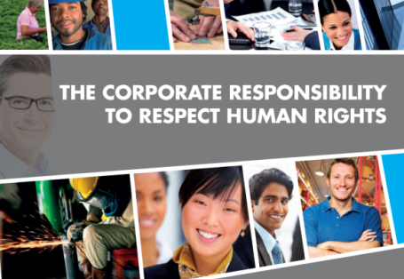
2011 United Nations Corporate Responsibility Guidelines
Business commit to respect human rights
Companies must stop violating human rights
Source: http://www.ohchr.org/Documents/Publications/HR.PUB.12.2_En.pdf
Notes:
Questions for discussion:
Does this mean that all companies respect all human rights in practice?
What human rights do you think companies might violate? (examples: working conditions, pollution)
Why would a company violate human rights? (increase profits – could discuss how this is a product of capitalism)

Slide 31
Summary
The world's first human rights systems were developed thousands of years ago!
Human rights must be fought for - many human rights applied only to certain categories (usually white males)
The enforcement of human rights is not 100% guaranteed in any country in the world
To what extent is climate change affecting people’s abilities to access their own rights? See
https://www.youtube.com/watch?v=PpqXVjUAM9A

Slide 32
Revisit your Reflection Tool and fill it in with your partner!

