Slide 1
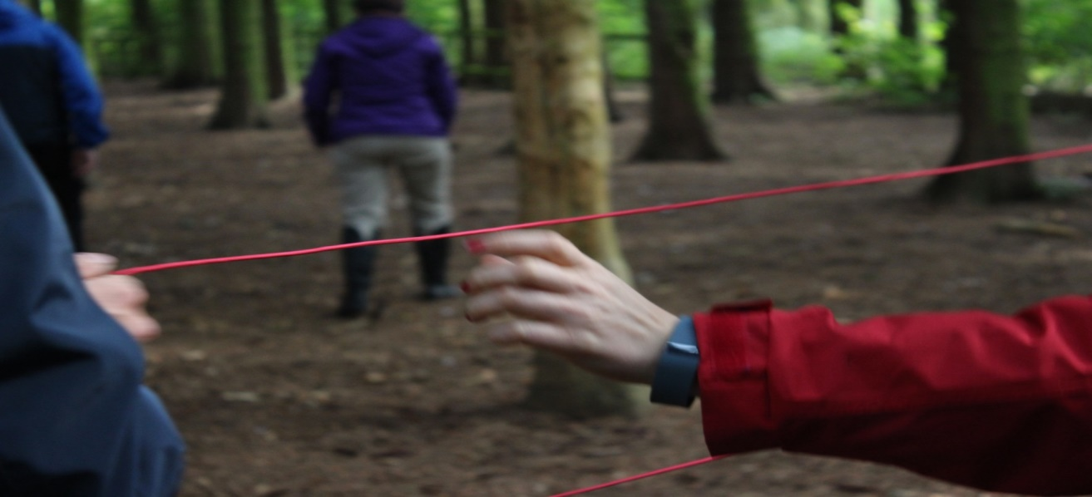
Your Global Footprint
Credit: based on Maths lesson ideas from David Brown, Nelson Mandela Schule, Berlin
The project ‘Global Fairness: Schools as Agents of Change’ has been funded with support from the European Commission. The contents of these actions are the sole responsibility of the contractor and can in no way be taken to reflect the views of the European Union.

Slide 2
GLOBAL
Notes:
Students discuss in pairs what the term means to them

Slide 3
“Ecological footprint”(or Global Footprint) is defined as the impact of a person or community on the environment, expressed as the amount of land required to sustain their use of natural resources. Picture it like a footprint in sand; your impact is the size of the area of land you leave a mark on.
See how you compare to the average!
Source: www.bestfootforward.com

Slide 4
Lesson aims
Calculate individual global footprint
Use the data to calculate how much CO₂, how many planets, or how many acres you consume
Plot the data using bar graph, stem and leaf plot
Find the range, the outliers, the mean, mode and median and the standard deviation
Discuss the data in terms of educating the public on these issues

Slide 5
How to Calculate Your Global Footprint
For each of the following categories, give yourself a score on the scoresheet
Give yourself a score that is reflective of your lifestyle habits, it might be somewhere in the middle of the scores shown
At the end, tally up your total

Slide 6
Electricity
Score 50: You use many standard appliances, often leaving them on or on standby
Score 2: You conserve electricity as much as possible and buy your power from renewable/green sources

Slide 7
Food
Score 100: You pay no attention to where your food is produced, consumer as much/whatever you like, and throw away food that goes past it’s ‘Best Before’ date or you no longer want
Score 32: You are vegetarian or vegan, eat food sources as locally as possible, and never waste food

Slide 8
Heating
Score 45: You keep your home warm at all times, have poor insulation and get high heating bills
Score 10: You only put on the heating when necessary and wear warm layers where possible, have excellent insulation in your home and get low bills

Slide 9
Paper
Score 10: You regularly purchase newspapers and new books, and buy writing paper made from virgin forest
Score 5: You share newspapers, borrow books from a library rather than buying them, and use recycled writing paper

Slide 10
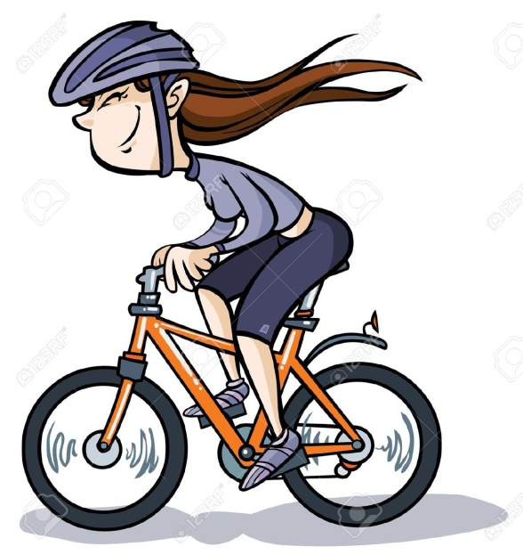
Local Transport
Score 75: You travel mostly by car
Score 10: You travel mostly by walking, cycling, or public transport such as bus or train

Slide 11
Waste
Score 100: Your black bin is always full and you don’t separate out your recyclable materials
Score 30: You really believe in the 4 Rs (refuse, reduce, reuse, recycle) and do all you can to stick by them

Slide 12
Water
Score 5: You take regular baths, and use a dishwasher, hosepipe etc
Score 1: You take mostly quick showers, and don’t have a dishwasher or garden hosepipe

Slide 13
Holiday
Score 65: You take at least one long haul flight a year
Score 10: You usually holiday close to home

Slide 14
What’s The Score?
Tally up your results and discuss with the class
The higher the score the bigger the footprint.

Slide 15
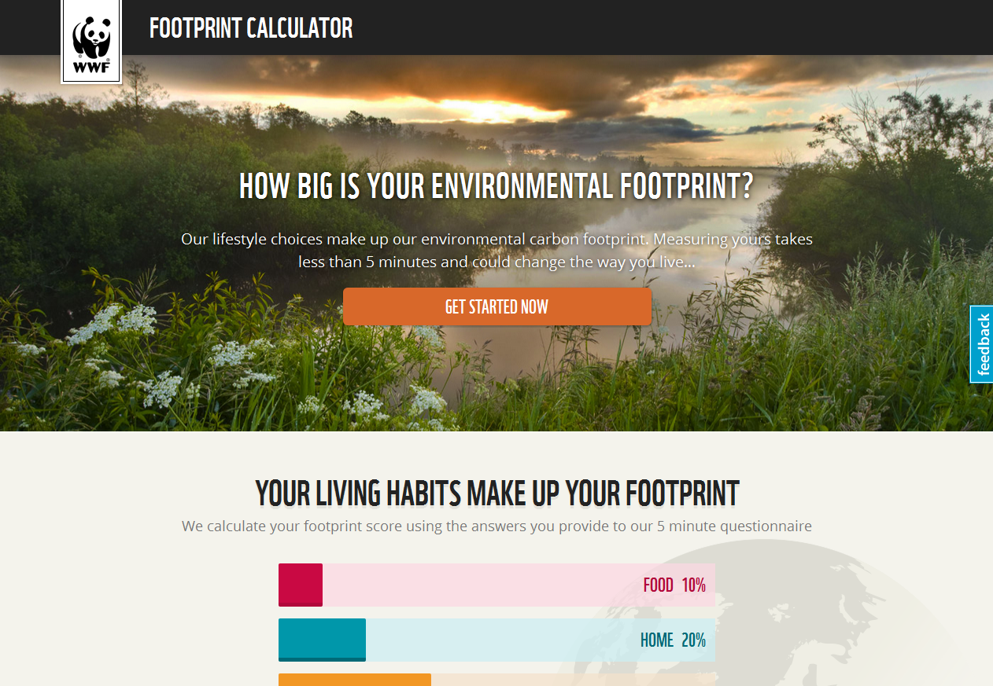
Alternatively, if your class can access a computer suite, each student can assess their footprint through this online questionnaire
http://footprint.wwf.org.uk/

Slide 16
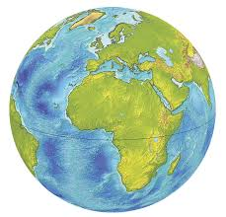
Global Footprint
If everyone in the world had a score of 100 or less we would need 1 earth to meet our needs
If everyone in the world had a score of 200 we would need 2 earths to meet our needs
If everyone in the world had a score of 300 we would need 3 earths to meet our needs

Slide 17
The class splits into girls and boys, and each calculates how much CO₂, how many planets, or how many acres they consume.
Plot the data using bar graph, stem and leaf plot, etc.
Find the range, the outliers, the mean, mode and median and the standard deviation.

Slide 18
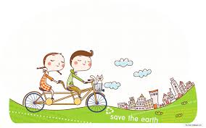
Discussion points:
Which statistic would you use to encourage the public to change their way of life?
Which factors contributed most to a high number of earths?
Is it enough to change only the extreme lifestyles (eliminate the outliers)
What are the next steps? How do we transmit the message to others?

Slide 19
Extension activity
Watch https://www.youtube.com/watch?v=EeV6ymLrmfg&feature=youtu.be
and discuss which of the young people’s actions will have the biggest impact on their ecological footprint (referring back to the data.)

