Slide 1
"El cambio climático" Spanish scheme of work Lesson 1
Educating across West Yorkshire for a just and sustainable world
The project ‘Global Fairness: Schools as Agents of Change’ has been funded with support from the European Commission. The contents of these actions are the sole responsibility of the contractor and can in no way be taken to reflect the views of the European Union.

Slide 3
Español
"El cambio climático"

Slide 4
The environmental and social impacts of climate change

Slide 5
Lesson 1
Learning outcomes:
Familiarise with the series theme
Understand that there are ecological and social impacts of climate change
Develop vocabulary linked to the environmental and social impacts of climate change.
Lesson objectives:
Match pictures with key terms
Play a memory game

Slide 6
Ecological consequences of climate change
Vocabulario | Vocabulary
(la) desertificación (las) lluvias fuertes (la) subida del nivel del mar los) corrimientos de tierra (las) condiciones metereológicas extremas (la) disminución de biodiversidad (las) tempestades (las) inundaciones (las) sequías (los) incendios forestales (las) olas de calor (el) derretimiento de glaciares | Desertification Heavy rain(s) Sea level rise Landslide(s) Extreme meterological conditions Decrease in biodiversity Storm(s) Flood(s) Drought(s) Forest fire(s) Heat wave(s) Glacial melting
Español
Inglés

Slide 7
Social consequences of climate change
Vocabulario | Vocabulary
(la) pobreza (el) desempleo (la) escasez de agua potable (las) malas cosechas (la) migración (las) guerras (las) víctimas mortals (el) aumento de personas sin hogar (el) hambre (las) pérdidas económicas (las) enfermedades (p.ej. Malaria) | Poverty Unemployed A drinking water shortage Poor harvest Migration War(s) Fatalities Increasing homelessness Hunger Economic losses/crisis Diseases (e.g. Malaria)
Español
Inglés

Slide 8
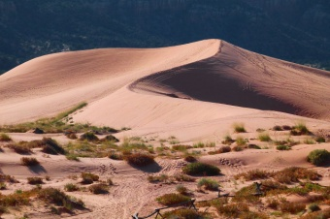
Tarea / Task 1
Match the photo with the correct Spanish word
For example:
(la) desertificación → (la) migración →
Desertification Migration
(Ecological) (Social)

Slide 9
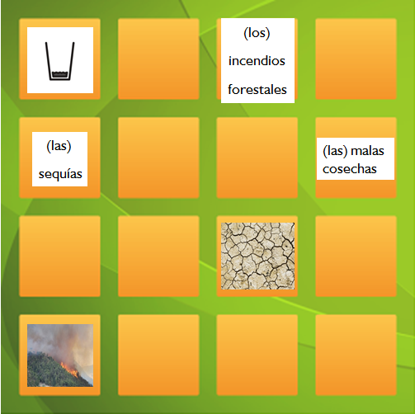
Tarea 2:
Comprobad vuestras soluciones.
Cortad las casillas con las imágenes y los términos españoles y jugad al memory.
Task 2:
Check your answers
Cut out the boxes and play a memory game
Español
Inglés

Slide 10
"El cambio climático" Spanish scheme of work Lesson 2
Educating across West Yorkshire for a just and sustainable world
The project ‘Global Fairness: Schools as Agents of Change’ has been funded with support from the European Commission. The contents of these actions are the sole responsibility of the contractor and can in no way be taken to reflect the views of the European Union.

Slide 11
Lesson 2
Learning outcomes:
To consolidate new vocabulary
To recognise relationships between the social and environmental impacts of climate change
Lesson objective: To create a mind map

Slide 12
Starter activity
Task: Play a memory game (e.g. pairs) with the cards from last lesson

Slide 13
Tarea / Task: Create a mind map
Instructions:
Take turns to choose a Spanish term and stick it onto the mind map
Draw lines between different terms to show the relationships between the different social and environmental impacts of climate change
Using the new vocabulary and the help box annotate your mind map to explain the relationships
Remember to speak lots of Spanish!

Slide 14
Así puedes indicar en español causas y consecuencias de un problema / Indicate the causes and consequences of a problem in Spanish
…es una consecuencia de… | ...is a result of...
…tiene varias consecuencias, por ejemplo… | ...it has several consequences, for example. …
...se debe a... | …is due to …
…causa… | ….cause…
…lleva a … / …da lugar a… | …it leads to / ...results in…
…también afecta a… | …it also affects…
…tiene que ver con… | ...it is related to...
…a causa de…/ debido a…/ por… | ...because of.../due to...
Otro efecto de… es… | Another effect of ...is...
Ejemplos: / Examples 1) Una sequía lleva a la falta de agua potable. / A drought leads to a lack of drinking water. 2) Las olas de calor tienen varias consecuencias, por ejemplo malas cosechas. / Heatwaves have several consequences , for example poor harvests. 3) Debido a las malas cosechas, mucha gente tiene que sufrir hambre. / Due to poor harvests, many people have to suffer hunger.
Español
Inglés

Slide 15
"El cambio climático" Spanish scheme of work Lesson 3
Educating across West Yorkshire for a just and sustainable world
The project ‘Global Fairness: Schools as Agents of Change’ has been funded with support from the European Commission. The contents of these actions are the sole responsibility of the contractor and can in no way be taken to reflect the views of the European Union.

Slide 16
Lesson 3: Research task
Learning outcomes: Understand how climate change affects people’s lives in Latin America
Lesson objectives: Research how climate change affects people’s lives in a specific Latin American country

Slide 17
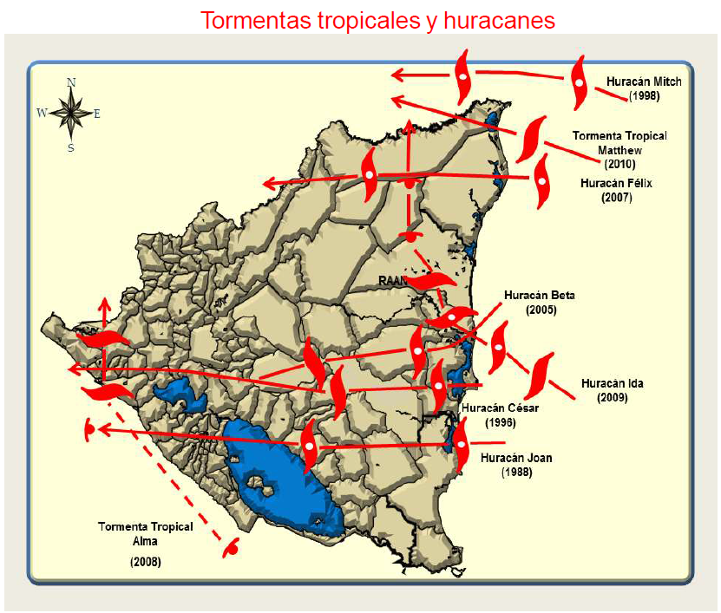
Example: The impact of climate change on coffee farmers in Nicaragua

Slide 18
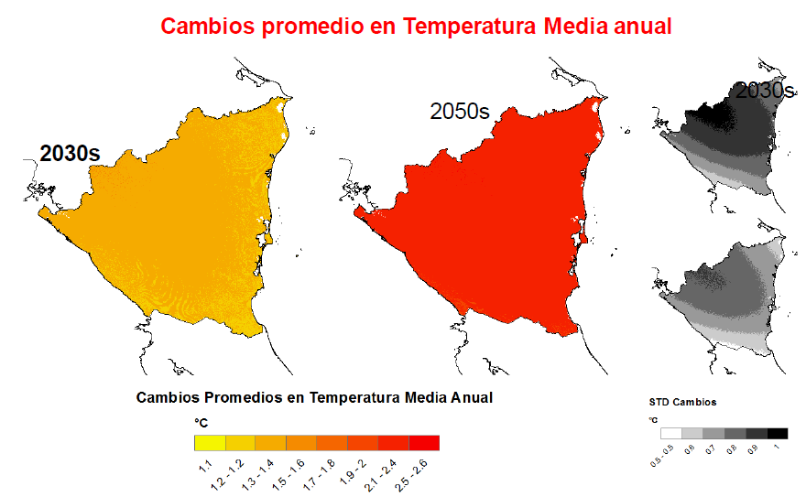
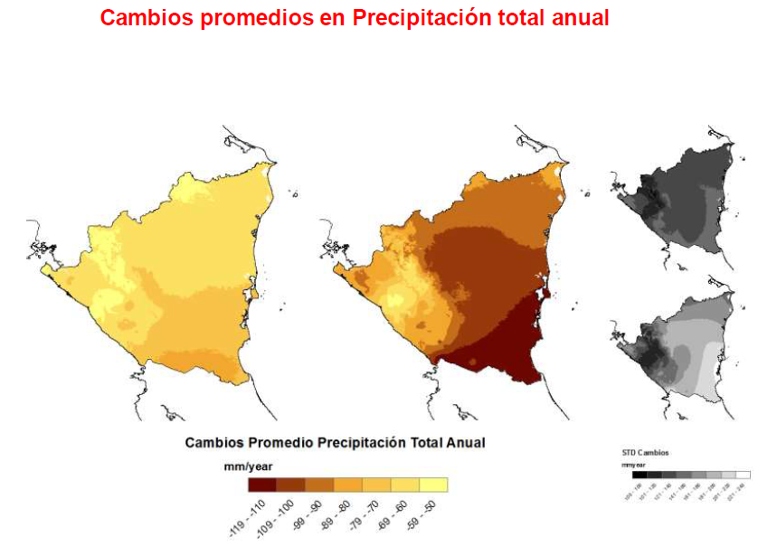
Example: The impact of climate change on coffee farmers in Nicaragua

Slide 19
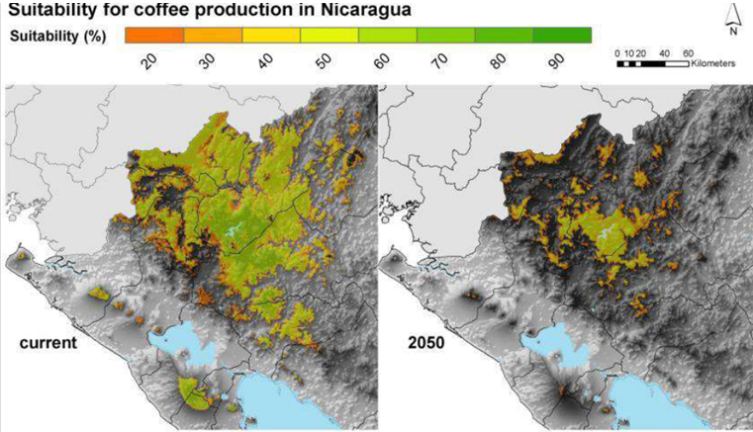
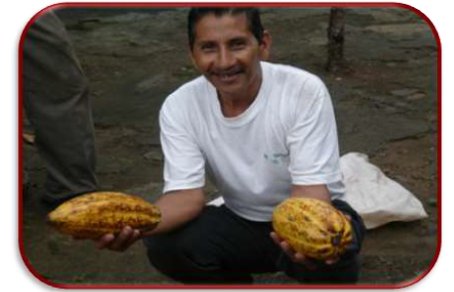
Example: The impact of climate change on coffee farmers in Nicaragua
El aumento de la temperatura promedio en Nicaragua en los últimos 50 años ha sido de 0,06 grados centígrados al año, lo que representa un incremento total de 3 grados centígrados en el último medio siglo
DIVERSIFICANDO LA PRODUCCION: ¿PORQUE INVERTIMOS EN CACAO?

Slide 20
"El cambio climático" Spanish scheme of work Lesson 4
Educating across West Yorkshire for a just and sustainable world
The project ‘Global Fairness: Schools as Agents of Change’ has been funded with support from the European Commission. The contents of these actions are the sole responsibility of the contractor and can in no way be taken to reflect the views of the European Union.

Slide 21
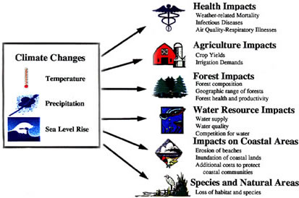
Lesson 4
Learning outcomes: Consolidate knowledge on the impacts of climate change in various Latin American countries
Lesson objectives: Present the information you have researched on a poster

Slide 22
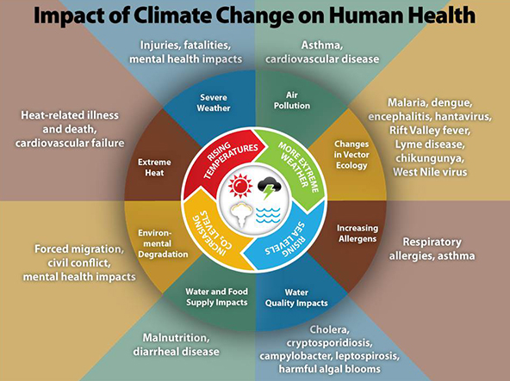
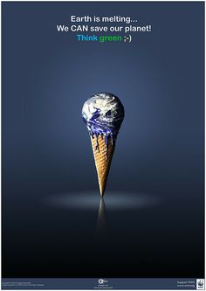
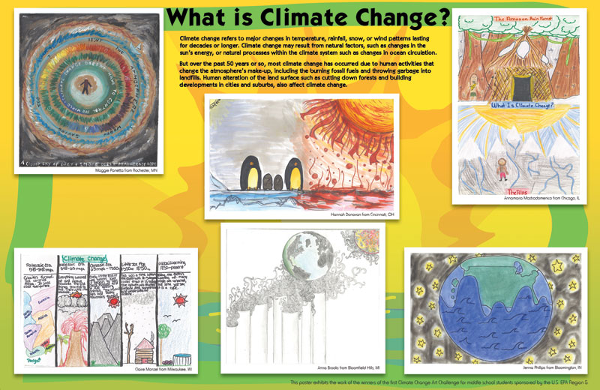
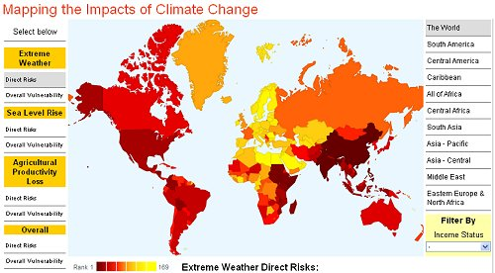
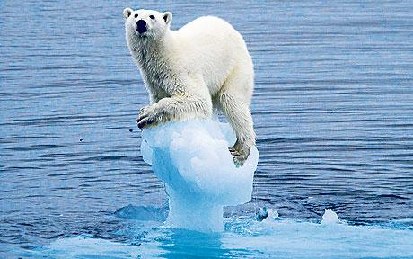
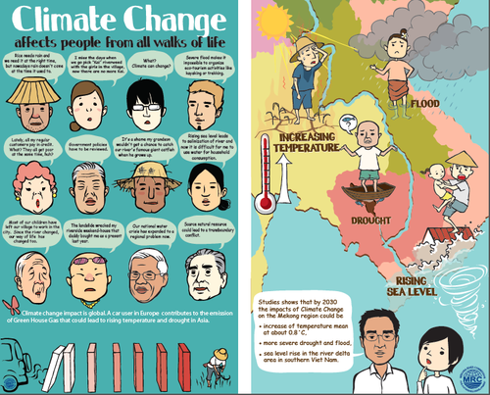

Slide 23
"El cambio climático" Spanish scheme of work Lesson 5
Educating across West Yorkshire for a just and sustainable world
The project ‘Global Fairness: Schools as Agents of Change’ has been funded with support from the European Commission. The contents of these actions are the sole responsibility of the contractor and can in no way be taken to reflect the views of the European Union.

Slide 24
Lesson 5: Presentation of posters
Learning outcomes: Understand the impacts of climate change in Latin America
Lesson objectives:
1) Present research posters
2) Complete a table on the impacts of climate change in other Latin American countries
3) Feedback on common impacts of climate change in Latin America
4) Reflect on the topic

Slide 25
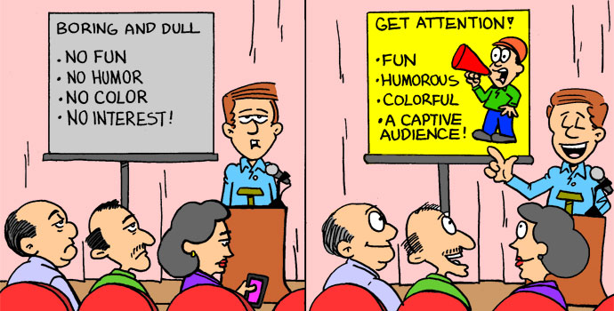
Present your posters!

Slide 26
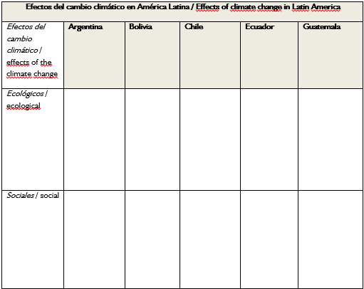
Lesson 5: Present your posters!
Español
Los efectos del cambio climático en países latinoamericano
Tarea: Ya te has informado sobre los efectos del cambio climático en un país latinoamericano. Ahora vas a saber más sobre los efectos que tiene el cambio climático en todo el continente. Escucha las ponencias de tus compañeros de clase y mira sus carteles. Con ayuda de esa información, rellena la siguiente tabla para tener una sobrevista sobre los efectos del cambio climático en los diferentes países de América Latina.
The effects of climate change in Latin American countries
Task: Listen to presentations delivered by your classmates and look at the posters they have produced. Then, using that infomation, fill in the following table on the ecological and social effects of climate change in the different countries of Latin America.
Inglés

Slide 27
Common impacts of climate change in Latin America

Slide 28
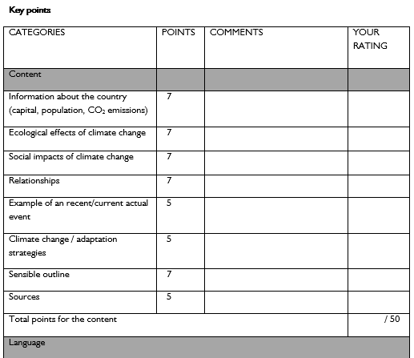
Lesson 5: Evaluate each other’s posters

Slide 29
Lesson 5: Reflection
(5b) Unit assessment “The effects of climate change in Latin America”
Yo sé… / I can... |  | ++ | + | +- | - | - -
…dar ejemplos de los efectos ecológicos del cambio climático …give examples of the ecological effects of climate change | In English
 | en español
…dar ejemplos de los efectos sociales del cambio climático …give examples of the social effects of climate change | In English
 | en español

Slide 30
"El cambio climático" Spanish scheme of work Lesson 6
Educating across West Yorkshire for a just and sustainable world
The project ‘Global Fairness: Schools as Agents of Change’ has been funded with support from the European Commission. The contents of these actions are the sole responsibility of the contractor and can in no way be taken to reflect the views of the European Union.

Slide 31
Lesson 6
Learning outcomes: Understand how to apply the grammatical form of the subjunctive
Lesson objectives:
1) Write a list of proposals for an upcoming Climate Change conference
2) Write a speech to the Latin American delegation

Slide 32
Lesson 6: Demands of the Latin American delegation to members of the global climate conference
Español
Tarea: Trabajad en grupos de cuatro alumnos. Primero cada alumno escribe ideas acerca del tema en una de las casillas blancas. Después de cinco minutos dad la vuelta a la hoja y leed lo que ha escrito cada uno del grupo. Discutid vuestras propuestas y escribid vuestras ideas comunes en la casilla gris.
Task:
Write your individual ideas in one of the white sections.
After five minutes, read what you have written and discuss your proposals
Write common ideas inside the grey box.
Inglés

Slide 33
Así puedes expresar en español esperanzas, propuestas y reivindicaciones | So you can express hopes, proposals and demands in Spanish
esperar que + subj. | to hope for / to expect...
pedir algo / pedir que + subj. | to ask for something / to ask ask that...
rogar algo / rogar que + subj. | to beg for something / to plead for....
exigir algo / exigir que + subj. | to demand something / demand that...
reivindicar algo / reivindicar que + subj.
reclamar algo / reclamar que + subj.
Es importante que… + subj. | It is important that...
Es necesario que…+ subj. | It is necessary that...
Hay que + inf. | We have to....
proponer algo / proponer que + subj. | to suggest something / propose that...
recomendar algo / recomendar que + subj. | to recommend something / to recommend that...
Ejemplos: / Examples Esperamos que los países industrializados como Alemania o Francia nos ayuden a adaptarnos mejor a los efectos ecológicos del cambio climático. / We hope that industrialised countries like Germany or France will help us better adapt to the ecological effects of climate change. Exigimos dos mil millones de Dólares para las víctimas de los últimos catástrofes naturales en nuestros países. / We demand two million dollars for the victims of recent natural disasters in our countries. Hay que proteger la biodiversidad en la Amazonía. / We have to protect the biodiversity in the Amazon.

Slide 34
Lesson 6: Reflection
(5b) Unit assessment “The effects of climate change in Latin America”
Yo sé… / I can... |  | ++ | + | +- | - | - -
…dar ejemplos de los efectos ecológicos del cambio climático …give examples of the ecological effects of climate change | In English
 | en español
…dar ejemplos de los efectos sociales del cambio climático …give examples of the social effects of climate change | In English
 | en español

